Slide 1

Getting Started with Caliburn.Micro and Windows Phone 7
Gary Ewan Park
gep13@gep13.co.uk
Twitter: @gep13
Blog: http://www.gep13.co.uk/blog

Slide 2
Agenda
What is Caliburn.Micro?
Blank Project
Navigation Service
Guarding Actions
More Conventions and Navigation
Using a Custom Service
Application Life Cycle
Tombstoning
Launchers and Choosers

Slide 3
Source Code
http://gep13.me/CaliburnMicroDemos
Notes:
Questions – feel free to ask them at any point, just throw up your hand, or if I don’t see you, feel free to shout at me.

Slide 4
My Development Rig…
Host Operating System:
Windows 8
Visual Studio 2012
Office 2013 Home Premium Preview
Virtual Machine
Windows 7
Visual Studio 2012
Windows Phone 7 SDK
Local Git Repo for all code
Local Nuget Repo for Packages

Slide 5
What is MVVM?

Slide 6
The answer…
Unfortunately, that is the topic of a whole other talk ☺
During the talk, if there are any concepts that you want covered, please feel free to ask, and I will do my best to answer the question
Have a look here for more info:
  http://gep13.me/MVVMPrimer

Slide 7
What is Caliburn.Micro?

Slide 8
A Definition…
“Caliburn.Micro is a small, yet powerful framework, designed for building applications across all Xaml Platforms. With strong support for MVVM and other proven UI patterns, Caliburn.Micro will enable you to build your solution quickly, without the need to sacrifice code quality or testability.”
Reference
  http://caliburnmicro.codeplex.com/
Notes:
Ask who is currently using Caliburn.Micro

Slide 9
What does that mean?
Caliburn.Micro is an Open Source Framework which helps with the development of MVVM applications
It supports:
  WPF 4.0
  Silverlight 4.0/5.0
  WP7
  WinRT
Ships as a Nuget package which can be easily added to your Projects
Strongly driven by Convention over Configuration
Project is coordinated by Rob Eisenberg (@EisenbergEffect)

Slide 10
Blank Project

Slide 11
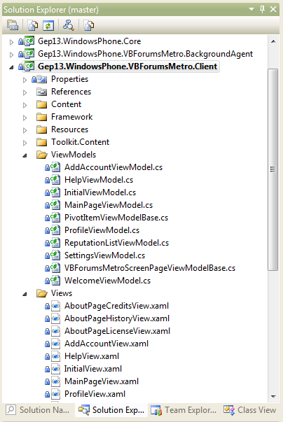
Get into good habits…
Caliburn.Micro has a number of conventions, but it helps if you get into good habits:
  Consistent Folder Structure
  Suffix Views and ViewModels
Once you do, the Caliburn.Micro magic starts working for you ☺

Slide 12
Get started with Caliburn.Micro in 4(ish) steps
Install Nuget Package
Adopt consistent folder structure
Clear out App.xaml and App.xaml.cs
Update WMAppManifest.xml
Job done…
Detailed steps can be found here:
http://gep13.me/CaliburnMicroDemo1

Slide 13
Demo 1
Blank Project
Using Caliburn.Micro on a New Project

Slide 14
Navigation Service

Slide 15
What is Caliburn.Micro doing for us?
AppBootstrapper
DI Container
MainPageViewModel
1
4
3
ViewModelLocator
MainPageView.xaml
2
5
Register MainPageViewModel Type
Navigation to MainPageView.xaml
Retrieve MainPageViewModel
Create on Request
Assign MainPageViewModel as DataContext, optionally assign matching properties from QueryString
Notes:
When Navigating To a Page
Use the new ViewModelLocator to conventionally determine the Type of the VM that should be attached to the page being navigated to. Pull that VM by Type out of the container.
If a VM is found, use the ViewModelBinder to connect the Page to the located ViewModel.
Examine the Page’s QueryString. Look for properties on the VM that match the QueryString parameters and inject them, performing the necessary type coercion.
If the ViewModel implements the IActivate interface, call its Activate method.
When Navigating Away From a Page
Detect whether the associated ViewModel implements the IGuardClose interface.
If IGuardClose is implemented and the app is not being tombstoned or closed, invoke the CanClose method and use its result to optionally cancel page navigation.1
If the ViewModel can close and implements the IDeactivate interface, call it’s Deactivate method. Always pass “false” to indicate that the VM should deactivate, but not necessarily close. This is because the phone may be deactivating, but not actually tombstoning or closing. There’s no way to know.

Slide 16
Demo 2
Navigation Service
Navigating between ViewModels with ease using the Navigation Service

Slide 17
Guarding Actions

Slide 18
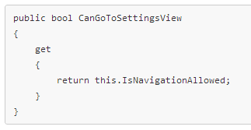
Wait, I want to prevent an action happening…
Any method, or navigation action, can be controlled (i.e. disabled) based on a Convention of prefixing a method call with Can…

Slide 19
Demo 3
Guarding Actions
Easily prevent/allow an action from occurring using only properties in ViewModel
Notes:
C:\Program Files (x86)\MSBuild\Microsoft\StyleCop\v4.4

Slide 20
More Conventions and Navigation

Slide 21
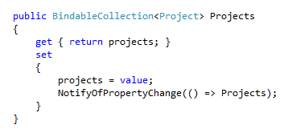
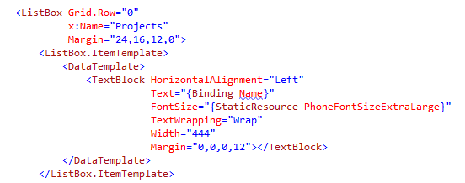
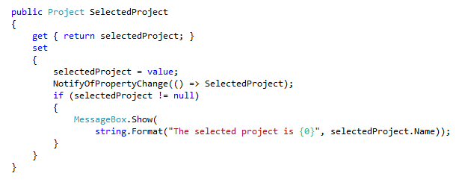
Apply Convention Binding to a ListBox

Slide 22
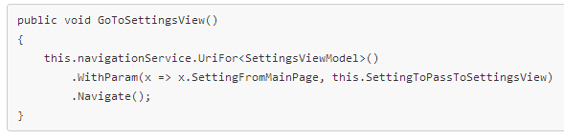
Assigning parameters to navigation Query String
Support for strongly typed navigation
Uses Fluent API to add information to resulting navigation QueryString
Full access to available ViewModel Properties
Never mistype a Uri or mess up a query string

Slide 23
Demo 4
More Conventions and Navigation
Applying Conventions to more complicated controls and passing variables between ViewModels

Slide 24
Using a Custom Service

Slide 25
DI Container For The Win
In addition to being able to provide ViewModels to the ViewModelLocator, Caliburn.Micro’s DI Container can also be used to provide other “services”
There are built in services already available
  NavigationService
  EventAggregator
  PhoneService
But there is nothing to stop you adding your own
These “services” can be used, when required, on any class, simply be adding them as a parameter into the constructor of the class

Slide 26
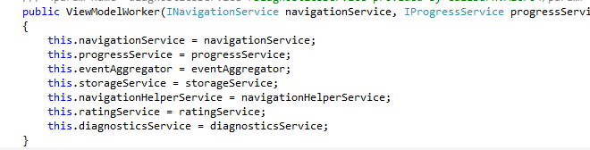
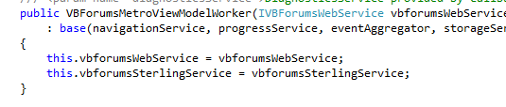
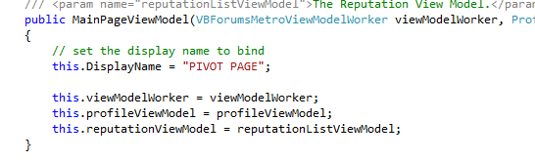
You can chain lots of these services together…

Slide 27
Demo 5
Using a Custom Service
Use the Caliburn.Micro Dependency Injection Container to provide services to ViewModel

Slide 28
Application Life Cycle

Slide 29
The IPhoneService…
No, nothing to do with the iPhone, sorry ☺
Exposes application level level events that make more sense than the built in events
  Launching – occurs when a fresh instance of the application is launching
  Activated – Occurs when a previously paused/tombstoned app is resumed/resurrected
  Deactivated – Occurs when the application is being paused or tombstoned
  Closing – Occurs when the application is closing
  Continuing – Occurs when the app is continuing from a temporarily paused state
  Continued – Occurs after the app has continued from a temporarily paused state
  Resurrecting – Occurs when the app is “resurrecting” from a tombstoned state
  Resurrected – Occurs after the app has “resurrected” from a tombstoned state

Slide 30
ViewModel Events
OnViewAttached
OnInitialize
OnActivate
OnViewReady
OnViewLoaded
OnDeactivate

Slide 31
Demo 6
Application Life Cycle
Tap into Application and ViewModel level events

Slide 32
Tombstoning

Slide 33
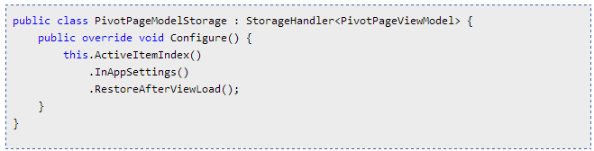
Tombstoning in Caliburn.Micro
Makes use of the events exposed in the IPhoneService to reliably and accurately save/restore important data
Extension methods provided for common user scenarios
Possible to persist information in both Application State as well as Phone State
Possible to define at which point the information is restored
Uses Fluent API to easily string user scenarios together

Slide 34
Demo 7
Tombstoning
Use Caliburn.Micro’s ability to Tombstone individual properties of a ViewModel into Application and Phone State

Slide 35
Launchers and Choosers

Slide 36

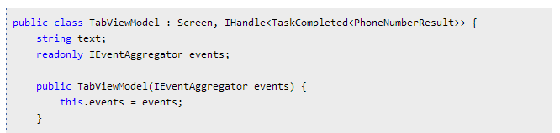
Launchers and Choosers
Launchers and Choosers are painful to work with if you want to do MVVM, not in Caliburn.Micro.
Built on top of the IEventAggregator
Using the IHandle interface, possible to return a TaskCompleted Generic which matches the Launcher/Chooser that you are using
Simple Subscribe/Unsubscribe model

Slide 37
Demo 8
Launchers and Choosers
Easily use Windows Phone 7 Launchers and Choosers in an MVVM pattern

Slide 38
The Future…
Does Caliburn.Micro support Windows Phone 8?
The answer is yes ☺
Check here for more information:
http://gep13.me/CMonWP8

Slide 39
Useful Links
An Introduction
  http://www.codeproject.com/Articles/175610/Caliburn-Micro-for-Windows-Phone-7
Project Home Page
  http://caliburnmicro.codeplex.com/
Work in Progress Sample Application
  https://github.com/gep13/VBForums-Viewer

Slide 40
Questions?
Feel free to email me any additional questions at
gep13@gep13.co.uk

